Slide 1
Cool Applications of D3.js
Thomas Gorry
@TGorry

Slide 2

About me
Thomas Gorry
T.Gorry@Liverpool.ac.uk
@TGorry
NeST Software Lab – Developer
University of Liverpool, Department of Computer Science Final Year PhD Student
Interested in:
C# .NET | ASP .NET | Java | PHP | JavaScript
Perl | Python | Others | Liverpool FC | Motorsports

Slide 3


Why Data Vis?

Slide 4
Why Data Vis?
Apple today announced financial results for its fiscal 2014 first quarter ended December 28, 2013. The company posted record quarterly revenue of $57.6 billion and quarterly net profit of $13.1 billion, or $14.50 per diluted share. These results compare to revenue of $54.5 billion and net profit of $13.1 billion, or $13.81 per diluted share, in the year-ago quarter. Gross margin was 37.9 percent compared to 38.6 percent in the year-ago quarter. International sales accounted for 63 percent of the quarter’s revenue.

Slide 5
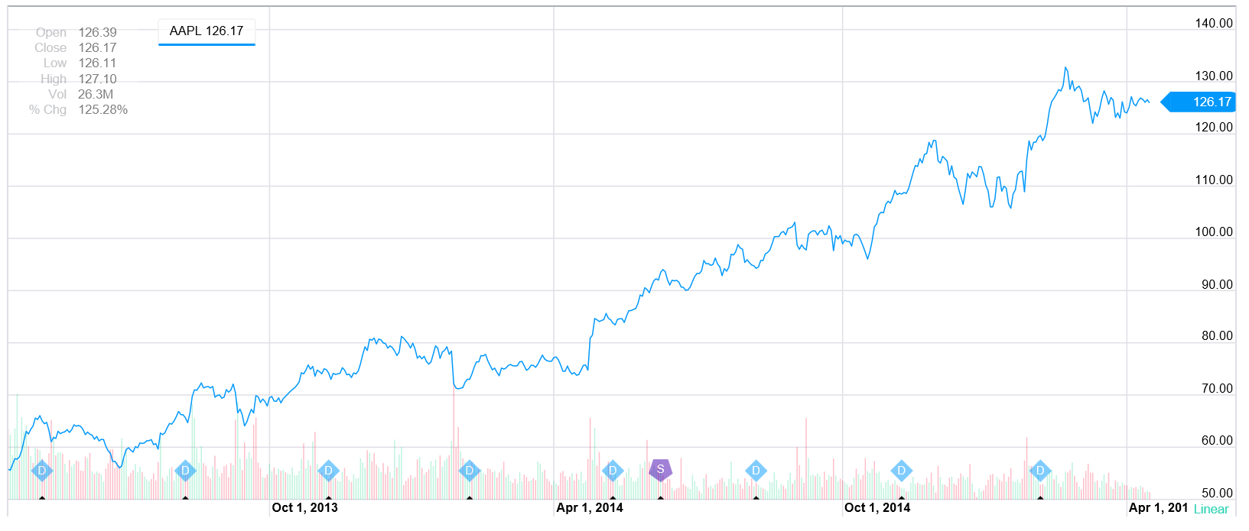
Why Data Vis?

Slide 6
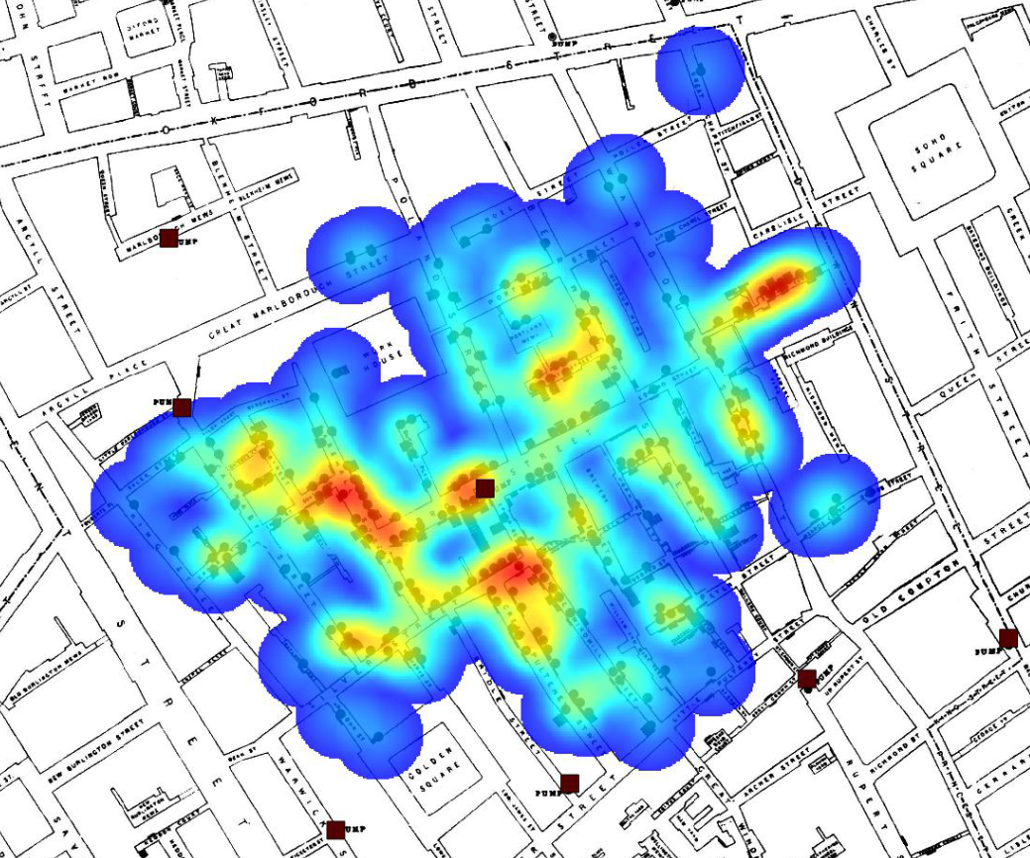
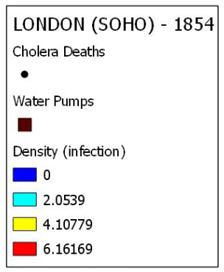
Why Data Vis?

Slide 7
Never heard of D3.js?

Slide 8
Never heard of D3.js?
D
ata
D
riven
D
ocuments

Slide 9




Never heard of D3.js?
What
Who
Why
When and Where

Slide 10
Never heard of D3.js?
What is D3.js?
JavaScript library for manipulating documents based on data.
Brings data to life using HTML, SVG and CSS.
Helps attach your data to DOM (Document Object Model) elements.

Slide 11
Never heard of D3.js?
Who develops D3.js?
Mike Bostock wrote D3.js based on his work during his PhD studies at the Stanford Visualization Group.
Mike now works at The New York Times who sponsors his open source work.
You can find Mike's github profile here => Mike Bostock Github Profile.
There are also many contributors that are adding a diverse set of components and plugins.

Slide 12
Never heard of D3.js?
Why use D3.js?
D3.js focuses on binding data to DOM elements.
D3.js is written in JavaScript and uses a functional style which means you can reuse code and add specific functions to your heart's content.
Which means it is as powerful as you want to make it. How you chose to style, manipulate, and make interactive the data is up to you.

Slide 13
Never heard of D3.js?
When should you use D3.js?
Whenever your webpage is interacting with data.
Where is D3.js used?
D3.js is a JavaScript library added to the front-end of your web application.
Your back-end (the server) will generate the necessary data.
The part of the application the users interact with (the front-end) will use D3.js.

Slide 14

Never heard of D3.js?
D3.js is not:
DOM query library
Compatibility layer
Charting library
Proprietary 3rd-party technology
Easy!

Slide 15
Quick Example?

Slide 16
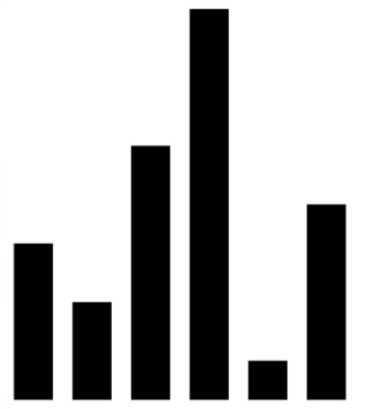
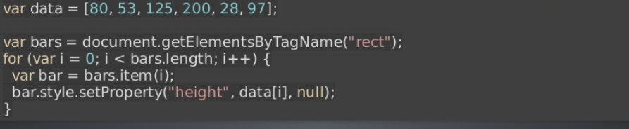
Quick Example?
With ordinary JavaScript:
With D3.js:

Slide 17
Better Examples?

Slide 18
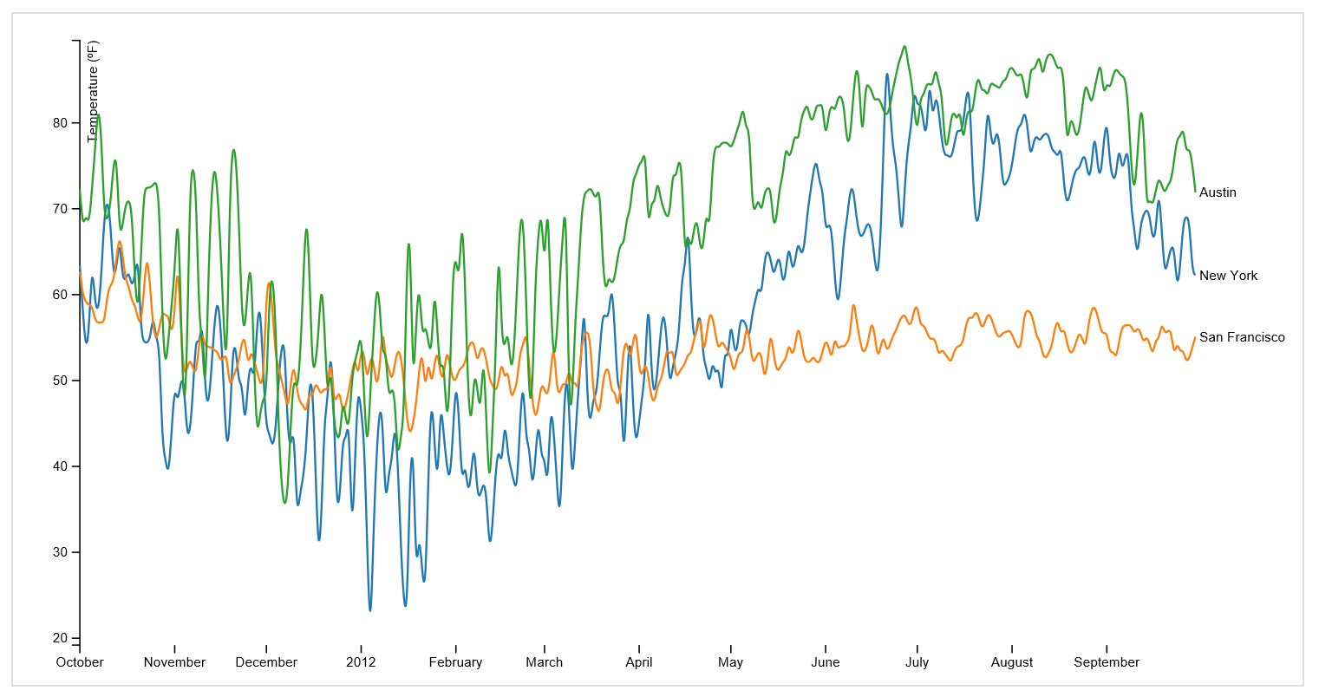
Better Examples?
How about better looking charts?
http://bl.ocks.org/mbostock/3884955

Slide 19
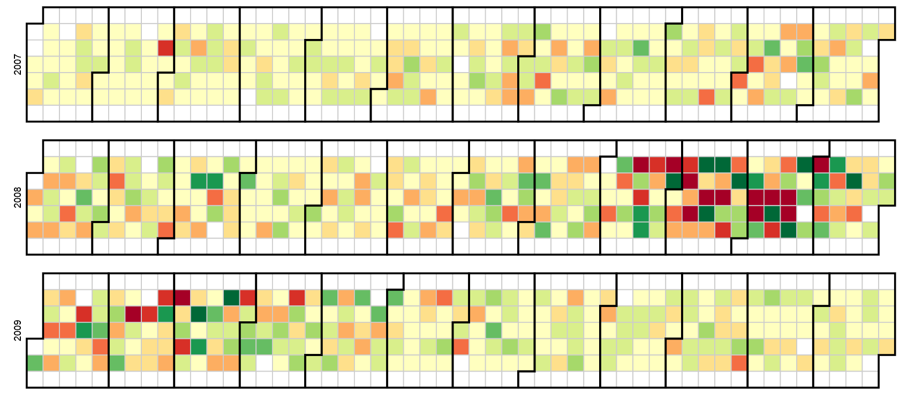
Better Examples?
What about yearly charts?
http://bl.ocks.org/mbostock/4063318

Slide 20
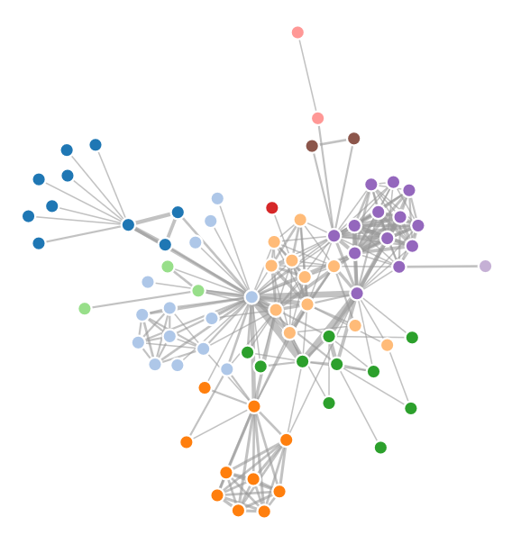
Better Examples?
You are right…. D3.js is not a charting library!
So what about interactive diagrams?
http://bl.ocks.org/mbostock/4062045

Slide 21
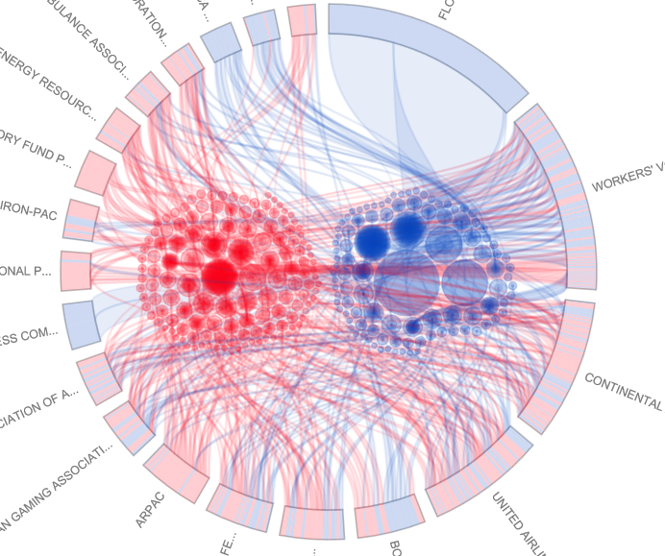
Better Examples?
That’s great, but what can interactive data visualisations give us other than a novelty factor?
http://www.brightpointinc.com/interactive/political_influence/index.html?source=d3js

Slide 22
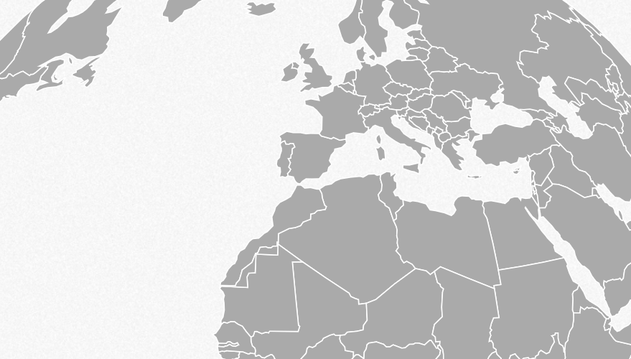
Better Examples?
I like the look of this D3.js thing, but how powerful can it really be?
http://mbostock.github.io/d3/talk/20111018/azimuthal.html

Slide 23
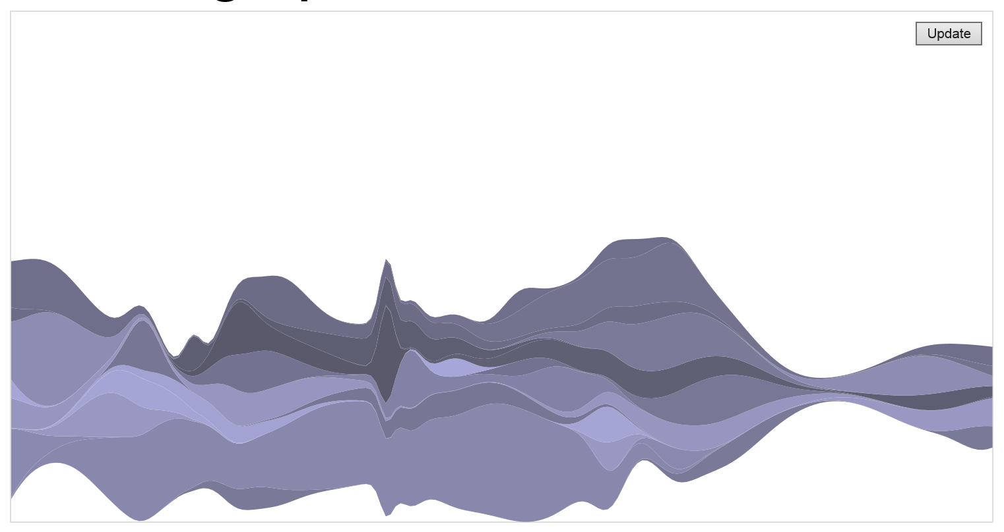
Better Examples?
Can I show a different data set or a live stream of data without refreshing the browser?
http://bl.ocks.org/mbostock/4060954

Slide 24
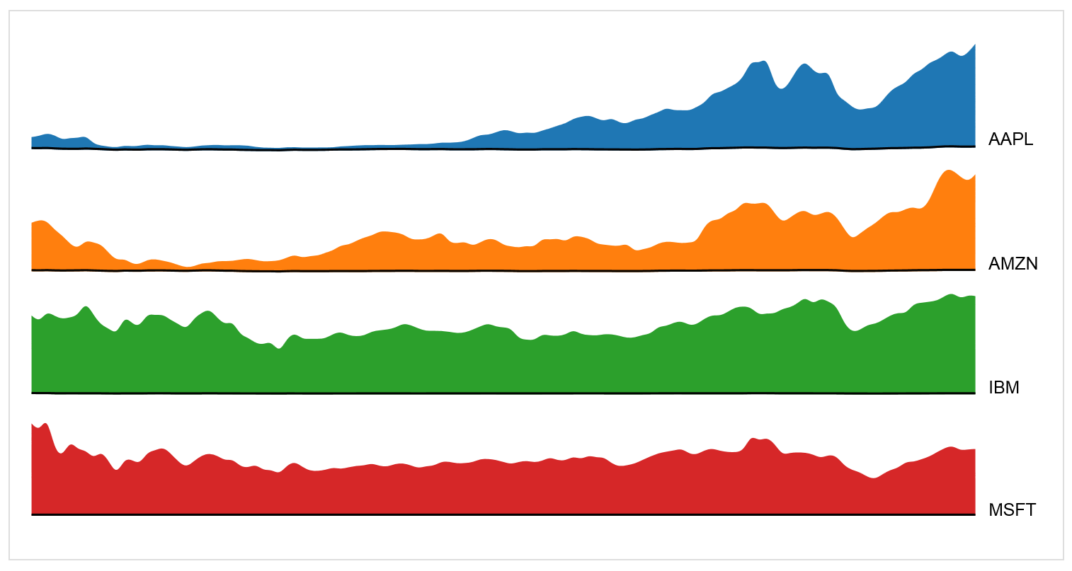
Better Examples?
Are there any limits on the type of transitions that can be performed?
http://bl.ocks.org/mbostock/1256572

Slide 25

Better Examples?
If I can automate transitions doesn’t that mean I effectively have video like looping capabilities for animations too?
http://vyacheslavryabinin.com/datavis/absind/

Slide 26
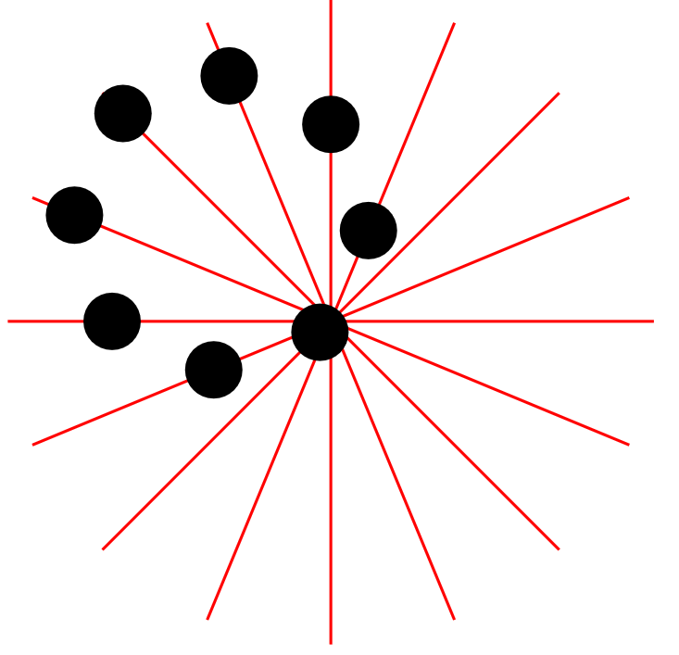
Better Examples?
I could probably use animations to create optical illusions too.
http://bl.ocks.org/peterlozano/480f90947c6e08be6b95

Slide 27
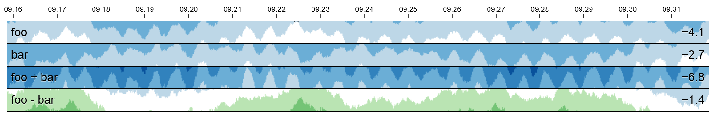
Better Examples?
Enough messing around, why are these animations and transitions useful?
http://square.github.io/cubism/

Slide 28
Application Examples

Slide 29
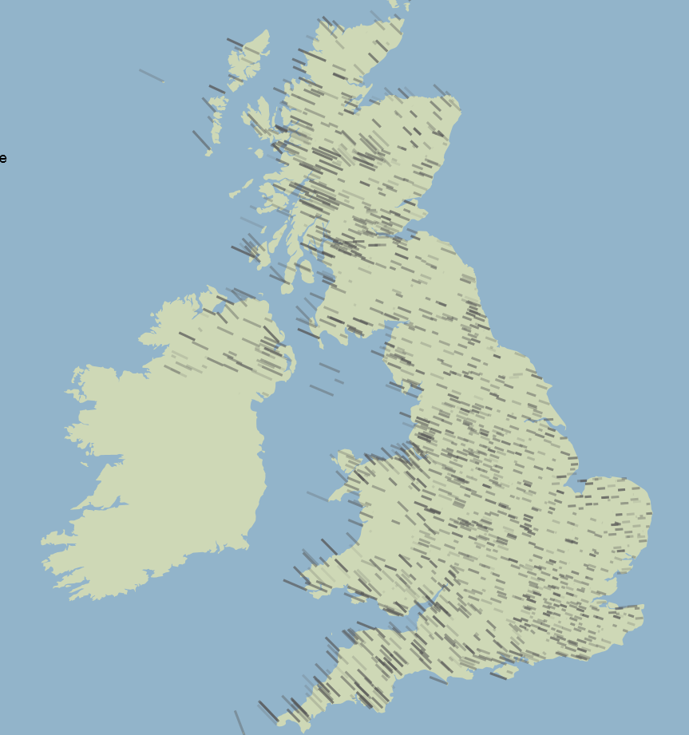
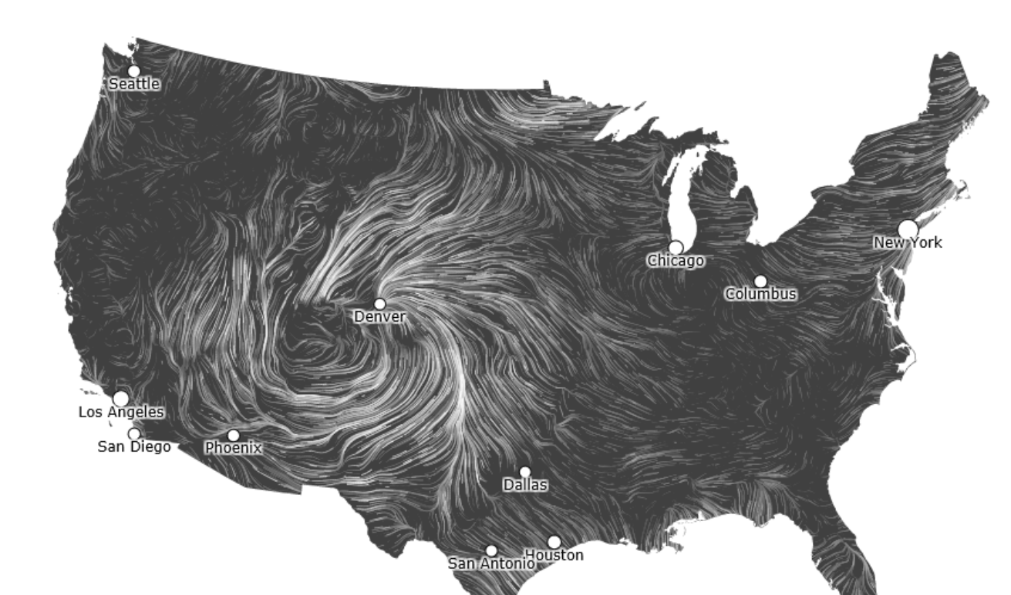
Application Examples
Weather based applications based on wind data.
http://charts.animateddata.co.uk/ukwind/
http://hint.fm/wind/

Slide 30
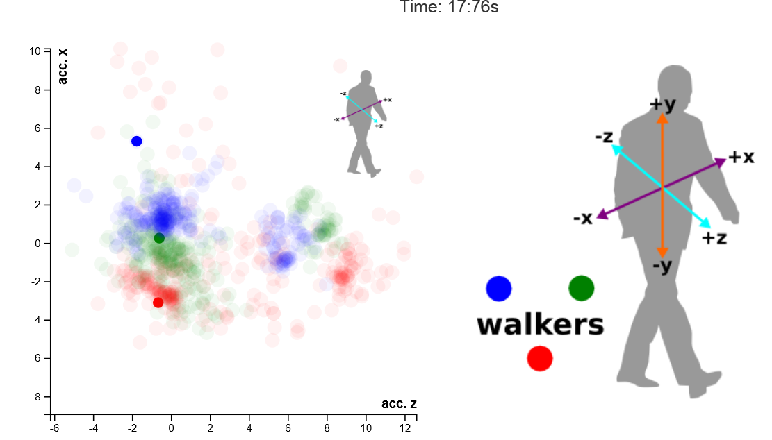
Application Examples
An application produced using biometric walking pattern data sets gathered through mobile phone accelerometers.
http://kyrandale.com/viz/d3-smartphone-walking.html

Slide 31
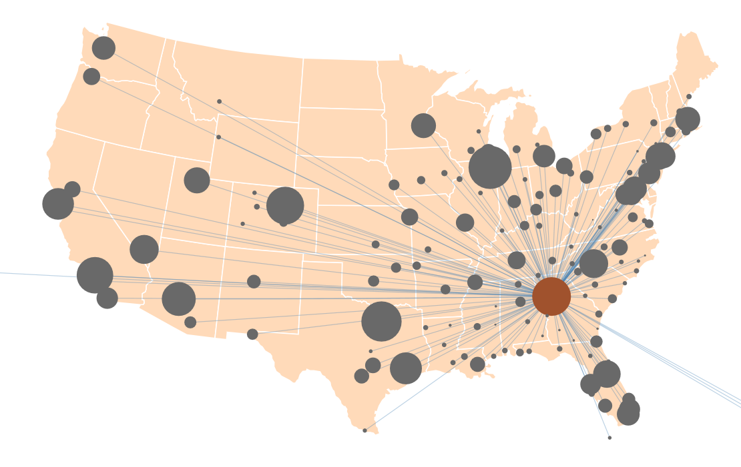
Application Examples
More on topic
Interactive USA flight delay application
http://xliberation.com/googlecharts/d3flights.html

Slide 32
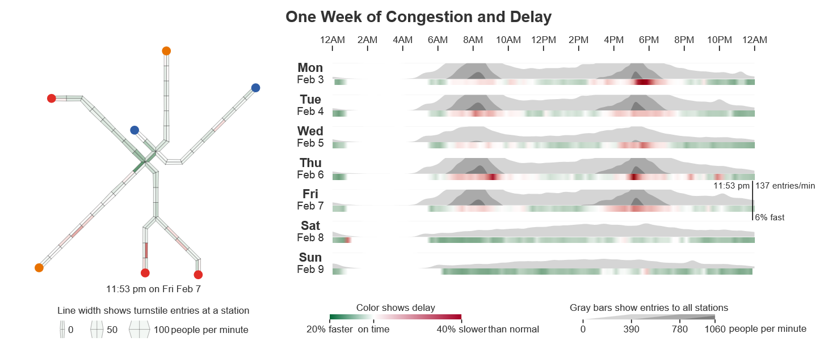
Application Examples
An interactive exploration of Boston's subway system
http://mbtaviz.github.io/

Slide 33



Keep in touch
Internet
http://www.liv.ac.uk/network-science-technologies/
http://www.csc.liv.ac.uk/~TGorry
Twitter
@TGorry
Mail
T.Gorry@Liverpool.ac.uk

Slide 34

Q&A

